Slide 1
Closing Speech
2019

Slide 2
Task 1.
Pair work: Make a dialogue, based on the following question.
--- What are the key elements in a closing speech?

Slide 3
Key elements
-Expressing thanks to keynote speakers, participants, moderator(s), organizer(s), and sponsor(s )
-Reviewing or summarizing briefly what have been done at the conference
-Evaluating the conference properly (achievements, significance, influences)
-Announcing the closing of the conference
-Extending invitation to the next conference

Slide 4
Task 2. Class work: Study one sample together.
Ladies and gentlemen,
I am now, on behalf of the organizing committee, to give the closing speech.
I believe that our Conference is a great success. It went smoothly as scheduled. In these five days the Conference has covered so many important and complex problems in the field of XYZ both theoretical and practical. All the presentations were very illuminating and informative. And the heated panel discussions were stimulating and fruitful. Now with great joy and a reluctant mind to part, we get together again to declare that the Conference has drawn to a successful close.
It is our hope that the result of the Conference will carry the study of XYZ to a new stage. We all hope to maintain close contact and cooperation with each other in the field of future research work on XYZ.
Purpose of the speech
Review and evaluation
Significance and expectation

Slide 5
As the organizer of the Conference, I would like to express our sincere thanks to the members of the International Committee, the members of the organizing Committee, and the authorities of Nanjing University and Jiangsu Province for all their support and contributions to this successful Conference. Thanks are also extended to all the participants who came from over 30 countries and regions. Thank you for your attention to all our sessions and thank you for your stimulating questions.
Now, the Conference is closed. Let’s meet again in London in 2018.
Thank you.
appreciation
Announcement

Slide 6
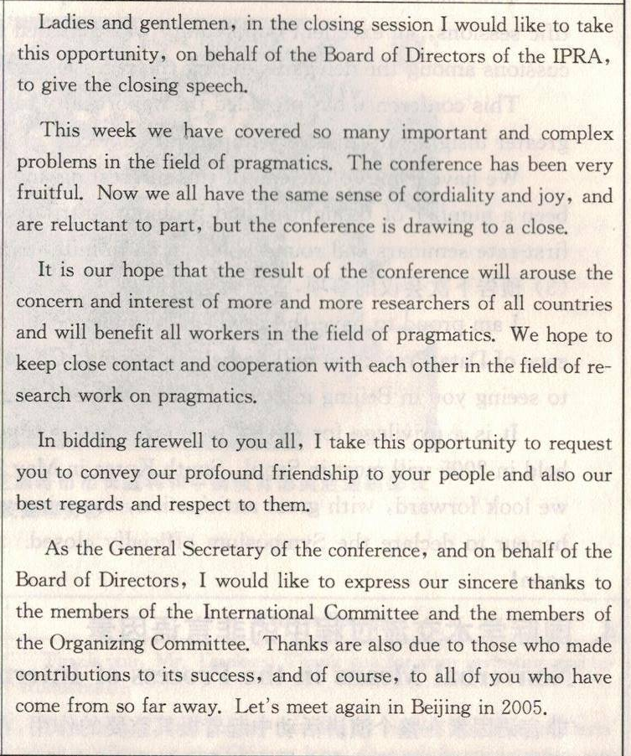
Task 3. Group work: Discuss and figure out what elements are included in the following closing speech.
Purpose of the speech
Review and evaluation
significance and expectation
Best wishes
appreciation and invitation

Slide 7
Task 4.
Group discussion: Try to find the difference between an opening speech and a closing speech.
One representative of each group reports to the whole class.

Slide 8

Comparison between an opening speech and a closing speech
Closing speech
Purpose: mark the opening
Elements: welcome and
appreciation
background
introduction
theme
agenda
good wishes
Purpose: mark the closing
Elements: appreciation and
summary
evaluation
expectation
invitation
closing

Slide 9
Task 5.
Group work: Complete the following closing remark.
Mr. Chairman, honored guests,
We (表示会议即将结束）_________________ a very fruitful congress. I (表示谢意）____________ our hosts and the authorities of the university, for their superb organization and for providing these magnificent facilities, （表示还要感谢）___________________ all the hardworking and dedicated staff, for making these meetings possible. And I （表示也要感谢）___________________ Professor John Smith for his able chairmanship.
The congress started officially yesterday and was supported by the presence of political , governmental, and academic members who stressed the importance of logistics and their implementation challenges in a global environment.
Several interesting aspects of logistics practices were （作讲演）______________ keynote speakers at the plenary sessions.
are coming to the end of
am grateful to
My thanks also go to
would also like to thank
presented by

Slide 10
The presentations of papers took place in three parallel sessions （涉及范围为）_________ eight topics in logistics. Although there were a large number of papers and time pressure, the audience (出席参与）______________ with great interest in learning the results of research of the scientists and business experts. Questions and discussions followed and triggered ideas for future research and applications, whereas the (交流）________ of opinions and the (结识）________ of the participants have formed the basis for future cooperation between them.
covering
attended and participated
exchanges
acquaintance

Slide 11
In closing, Mr. Chairman, allow me to thank all the participants for enriching these meetings with their presence and their views. I （盼望）_____________ making progress on all of the issues we discussed at our meetings next year in New York City under the chairmanship of Professor Henry Levin.
look forward to

Slide 12
Task 6. Group work:
To deliver a Closing Speech by simulating:
1) Conference sponsor / organizer
2) Mayor of the host city
3) President of the host university
4) Conference chair
5) Government leader
6) Leader of an international organization

Slide 13
Assignment:
Practice these patterns and expressions often used in closing speeches.

Slide 14
1. Expressing thanks
-I wish to thank all the speakers, and other participants for their valuable
contributions.
- I would like to thank various people. First of all, the chairpersons for their
efficient ways in which they handled their sessions. Second, the speakers for
their excellent presentations. Third, the delegates for having been an
excellent audience and having provided stimulating discussions. Last but
not least, I would like to thank the companies for the financial support and
cooperation we received in organizing and conducting this conference.
- On behalf of all the members of our Organizing Committee, I wish to
express our sincere gratitude to all of you who have so actively participated
in this congress to make it such a success. I now extend best wishes to all of
you and I look forward to seeing you again at the next congress two years
hence in Beijing.
- Let me congratulate you for the achievements of this conference. This was
the result of very hard work by delegates under the very competent
leadership of the chairman.

Slide 15
- Let me congratulate you for the achievements of this conference. This was the
result of very hard work by delegates under the very competent leadership of
the chairman.
- Thank SEU for hosting the conference. Thanks go to everybody who has
contributed to the conference with reports and introductions. Thanks for the
financial contributions to this conference from the city and all other
organizations and a number of private sponsors.
- As the organizer of the conference, I would like to express our sincere thanks
to the members of the Organizing Committee, the authouities of Nanjing
University and Jiangsu Province for all their support and contributions to this
successful conference. Thanks are also due to all the participants who came
from over 30 countries and regions.
- Thanks to the European Commission, we have been able to publish the
proceedings of the congress. Finally, a word of thanks to our sponsors,
without whose help our debts would not have been so immense. Our heartfelt
thanks go to each and everyone of you. Without your participation, we would
never have enjoyed these three days so much, and we would have missed out
an experience which will doubtless remain forever in our hearts.

Slide 16
2. Summarizing the achievements
- Despite all of the inevitable small difficulties, there have been
a number of thoughtful and probing contributions in plenary
sessions, and many first-rate seminars and roundtables on an
infinite number of subjects.
- We talked a lot, we discussed a lot and also we recommended
a lot of things,such as ...
- In the past few days you have been addressing themes of paramount
importance, and please allow me to express my admiration for
and appreciation of your wisdom in these fields, since such
wisdom is the basis for action.
- We have spent many hours and days debating and discussing 4000
pages—yes, we have printed 4000 pages in the conference
proceedings. I am sure the output of so much work and effort will be
productive, and result in concrete and tangible benefits to the need
of the world.

Slide 17
- We are now very close to the end of this International Conference
which has achieved tremendous successes. More than 200
participants have come to Manhattan to discuss not only general
questions about XXX but more concrete questions and problems
and their possible solutions.
- We have worked actively in the workshops these days, and our
work has provided value not only to the resolution but also to the work of
this Association in general.
- I believe that our conference is a great success. It went smoothly as scheduled.
In these five days the conference has covered so many important and
complex problems in the field of biochemistry, both theoretical and practical.
All the presentations were very illuminating and informative. And the heated
panel discussions were very stimulating and fruitful.
- Our conference has lasted three days. It has achieved tremendous successes.
Eighteen scientists and scholars spoke at the conference. Many more aired
their views freely at group discussions, which proceeded in a friendly and
lively atmosphere. I benefited greatly by attending this conference.

Slide 18
3. Announcing the next conference
- I'm delighted to invite all of you to prepare to come to Canada
in four years to participatein the ... Conference.
- Our next conference will be held in New York at our college.
We will try our best to make the forthcoming gathering another
fruitful and pleasant one. I’m looking forward to meeting you
then.
- And lastly, my friends, see you next year in Beijing, China for
our next conference.
- I look forward to seeing you again at the next conference two
years hence in Nanjing in 2014. You will be warmly welcome
there.
- Let us meet again in Paris in 2014 at the next world congress
of biomaterials.

Slide 19
- It is a privilege for me to announce that the next
congress will be held in London in 2014.
- I am proud to have the privilege to announce that the
next International Conference on Strategies for Enhancing
Access to Medicine will be held in China in May 2014. We
should of course welcome as many scientists as possible.
We look forward to seeing you then.

Slide 20
4. Announcing the closing of the conference
- We are now very close to the end of this 3rd Conference of ...
- Now with great joy and a mind reluctant to part, we get together again to declare that the Conference has drawn to a successful close.
- We are soon closing this seminar which has been a great suess.
-I now have the duty and the honor to declare the conference officially closed.
-Now, the conference is closed. Let’s meet again in Beijing in 2020.

Slide 21
5. Expressing good wishes
- I wish everybody a good journey home.
- For now, I wish you all a safe journey back home.
- And lastly, my friends, see you next year in London and have a safe trip home.
-I hope you will have a safe and peaceful journey home and offer to you my warmest best wishes.
- Thank you, I wish you a pleasant trip home, and I will see you again.

Slide 22
Thank you!

